Slide 1
Simple Linear Regression: Fit Quality, (R^2), and Hypothesis Testing
Chapter 6
Built from current SLR slides 35-70 plus the conceptual t-test bridge from the appendix

Slide 2
Concept Review: Estimating One-Dimensional Data
We evaluate how good our estimate is by the Mean Square Error (MSE)
The MSE of one-dimensional data is Variance.
Weight

Slide 3
When we have an additional variable…
We want to evaluate if knowing something else about the data points (some set of $x_{i}$ for each $y_{i}$) tells us more than just the $y_{i}$ data by itself.

Slide 4
When we have an additional variable
If we have two data points, we can fit a line perfectly between them.

Slide 5
When we have an additional variable
But what if we have more?
In linear algebra, this meant we were overdetermined.

Slide 6
When we have an additional variable
So last week, we fit the line using the least squares estimator.
But how good is this fit?

Slide 7
An Intuitive Look
Pediatric Patients: Estimating Weight
Which of these two is a more effective predictor of weight?
Weight
Weight
Height
Favorite Color

Slide 8
Again: MSE
We look at the vertical distances of the data points to our prediction.
What are these called again?
In this case, we square each of these distances, and take their mean. (MSE)

Slide 9
Simple Linear Regression
Last week we used calculus to find the slope and the y-intercept of the Least Squares Estimator (LSE) line.
We proved that the LSE is the solution that minimizes MSE.

Slide 10
Simple Linear Regression
Think of choosing the slope and y-intercept as rotating the best fit line, and calculating the resulting MSE.

Slide 11
Simple Linear Regression
If we plot that rotation vs MSE, then what we did was select the rotation at the bottom of the curve.
Calculated MSE
$\hat{y}={\hat{β}}_{1}x+{\hat{β}}_{0}$

Slide 12
Simple Linear Regression
With univariate data (just $y_{i}$) we said the best estimate was the mean.
Weight

Slide 13
Simple Linear Regression
With two-dimensional data, notice the $y_{i}$ values are the same. They are just ordered differently WRT the predictors $x_{i}$.
Weight
Weight
Weight
Height
Favorite Color

Slide 14
Simple Linear Regression
If the estimator is essentially meaningless, then the slope ${\hat{β}}_{1}=0$ and the y-intercept ${\hat{β}}_{0}=𝔼[Y]$.
Weight
Weight
Favorite Color

Slide 15
Simple Linear Regression
In other words, when the predictor variable is not useful at all, the sums of the squared errors (residuals) is the same as the sum of the squared errors of $\left\{y_{i}\right\}$ by itself, $Var[Y]$.
Weight
Weight
Favorite Color

Slide 16
Takeaway
We can say that predicting $Y$ using just the observed $y_{i}$ itself is the same as predicting $Y$ using $(x_{i},y_{i})$ when the least squares estimator line has zero slope.

Slide 17
Meaningful Predictor
When we do see a predictor variable that appears to have meaning, then we would fit a line with a non-zero slope.
Weight
Height

Slide 18
Simple Linear Regression
In this case, we expect the sum of the squared errors to be less than if we had predicted $Y$ as $𝔼[Y]$.
Weight
Weight
Height

Slide 19
$R^{2}$: Measure of how much a predictor variable tells us
How much of the variation in $Y$ does the model explain with $X$?
$$R^{2}=\frac{TSS−RSS}{TSS}$$
$TSS$: Total Sum of Squares
$RSS$: Residual Sum of Squares

Slide 20
$R^{2}$: Measure of how much a predictor variable tells us
How much of the variation in $Y$ does the model explain with $X$?
$$R^{2}=\frac{SS_{mean only }−SS_{fit}}{SS_{mean only}}$$

Slide 21
Let’s unpack this some more
What is the worst we can ever do?
If our predictor is the same as taking the mean of $Y$ without considering the predictor, $R^{2}=0$.
$R^{2}=\frac{SS_{mean only }−SS_{fit}}{SS_{mean only}}$
Weight
Weight
Favorite Color

Slide 22
Let’s unpack this some more
What is the best we can ever do?
If our predictor and response variables form a straight line, the residuals are all zero.
$R^{2}=1$
$R^{2}=\frac{SS_{mean only }−SS_{fit}}{SS_{mean only}}$
Weight
Weight
22
Amazing Predictor

Slide 23
Why this works
Recall the first of our “big three” assumptions:
Weight
Weight
Weight
Height
Favorite Color

Slide 24
Takeaways
$R^{2}∈[0,1]$.
If we have a predictor with an $R^{2}$ value of $0.25$ (ex: wrist circumference) and another predictor with $R^{2}=0.50$ (ex: height), we can say that
“Height explains twice as much variance as wrist circumference when estimating weights of pediatric patients aged 12.”
Good to know, but not as useful for MLR:
Recall correlation: $r=Cor\left(X,Y\right)=\frac{Cov\left(X,Y\right)}{\sqrt{Var\left[X\right]Var\left[Y\right]}}$
It turns out that $R^{2}=r^{2}$

Slide 25
Limitations
$R^{2}$ doesn’t tell us everything.
Example: What if we had only two data points?

Slide 26
Limitations
Example: What if we had only two data points?
$SSE=0 ⇒R^{2}=1$. A perfect fit!

Slide 27
Limitations
$SSE=0 ⇒R^{2}=1$. A perfect fit!
But what if we start applying it to test data?

Slide 28
Limitations
Therefore, $R^{2}$ alone does not tell us whether the model is statistically meaningful.
$R^{2}$ doesn’t tell us whether the slope is distinguishable from zero.
It measures fit, not statistical evidence.
Does not account for sampling variability, noise level, or uncertainty of the estimated slope.

Slide 29
Enter: The F-test
We want to get a statistical significance of our fit.

Slide 30
Decomposition and Comparison to $R^{2}$
$R^{2}$ can be rewritten as
$$R^{2}=\frac{\frac{1}{n−1}}{\frac{1}{n−1}}×\frac{SS_{mean only }−SS_{fit}}{SS_{mean only}}$$
(using a “can’t stop me” rule).
This means, in variance terms:
$$R^{2}=\frac{Var\left[mean only\right]−Var\left[fit residuals\right]}{Var\left[mean only\right]}$$

Slide 31
Decomposition and Comparison to $R^{2}$
In variance terms:
$R^{2}=\frac{Var\left[mean only\right]−Var\left[fit residuals\right]}{Var\left[mean only\right]}$
$=\frac{Reduction in Variation when considering height}{Variation in weight without considering height}$
Weight
Weight
Height

Slide 32
F-statistic
In variance terms:
$f_{observed}=\frac{Var\left[mean only\right]−Var\left[fit residuals\right]}{Var\left[fit residuals\right]}$
$=\frac{Reduction in Variation when considering height}{Variation in weight not explained by height}$
The numerator is the same as $R^{2}.$
The denominator is slightly different.
Weight
Weight
Height

Slide 33
F-statistic
Mathematically, given $p$ parameters and $n$observations:
$$f_{observed}=\frac{\frac{SS_{mean only}−SS_{fit}}{p_{fit}−p_{mean only}}}{\frac{SS_{fit}}{n−p_{fit}}}$$
In SLR, ${ p}_{fit}=2 ({\hat{β}}_{0}$ and ${\hat{β}}_{1}$), while ${ p}_{mean only}=1$ ($\overline{y}).$

Slide 34
F-statistic
Mathematically, given $p$ parameters and $n$observations:
$$F=\frac{SS_{mean only}−SS_{fit}}{\frac{SS_{fit}}{n−p_{fit}}}$$
What happens to the F-statistic as the number of observations $n$ gets larger?

Slide 35
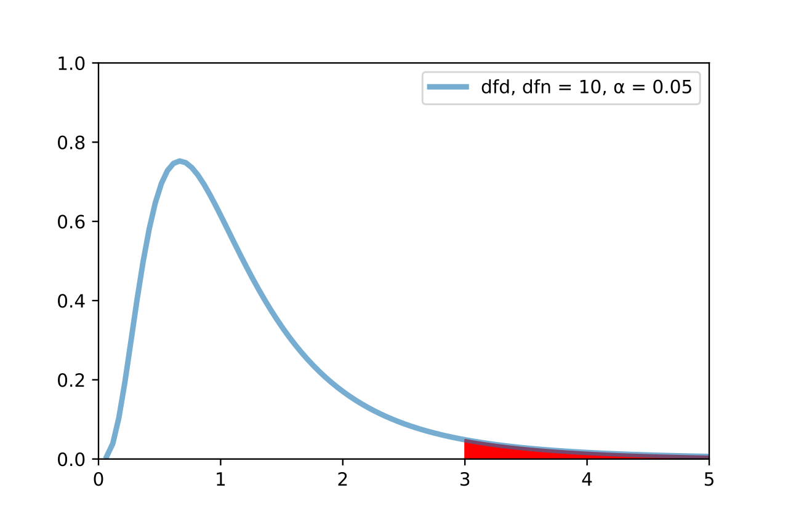
The F-Distribution
We then use the F-Distribution to calculate a p-value.
$$p=𝒫(F_{df\left(numerator\right),df\left(denominator\right)}≥f_{observed})$$
Image adapted from F-test plot.svg, Gase456, CC by 4.0. Retrieved from https://en.wikipedia.org/wiki/F-test.

Slide 36
Mathematical Interpretation
The F-test answers:
Does this model beat the null (random) model? (Think: favorite color vs weight of our pediatric patients)
Is there evidence that the slope is not zero?
Hypothesis test:
$$H_{0}:β_{1}=0 vs H_{A}:β_{1}≠0$$

Slide 37
Why this works
Recall the second “big three” assumption:
And the third “big three” assumption:
And the uncorrelated assumption from #2 automatically gives us independence with the Normal/Gaussian assumption.

Slide 38
What about the t-tests?
In R and Python/statsmodels, we see linear model summary output with t-test p-values as well.
For SLR, the t-test for ${\hat{β}}_{1}$ is mathematically equivalent to the F-test.
In MLR, they diverge. We will get into that later this week.

